Slide 1
CrisprVi: a software for visualizing and analyzing CRISPR sequences of prokaryotes
John Wesley Mathis
ECE/SSE 591

Slide 2
What is CRISPR?
Clustered Regularly Interspaced Short Palindromic Repeats
Natural defense mechanism in bacterial immune system
CRISPR regions contain short, repetitive DNA sequences interspaced with unique sequences called spacers
CRISPR is used to store genetic info from past viral infection and recognize and destroy invading viruses in subsequent encounters
Notes:
What does CRISPR stand for?
Where is it found?
as regions that contain short repetitive DNA sequences interspaced with unique sequences called spacers
originally discovered as a defense mechanism against viral infections
stores the genetic information about past viral encounters

Slide 3
What is Cas?
CRISPR-Cas System
CRISPR-associated (Cas)
Proteins essential for bacterial adaptive immunity
Notes:
CRISPR-Cas9?
proteins (enzymes) involved in the CRISPR immune response.

Slide 4
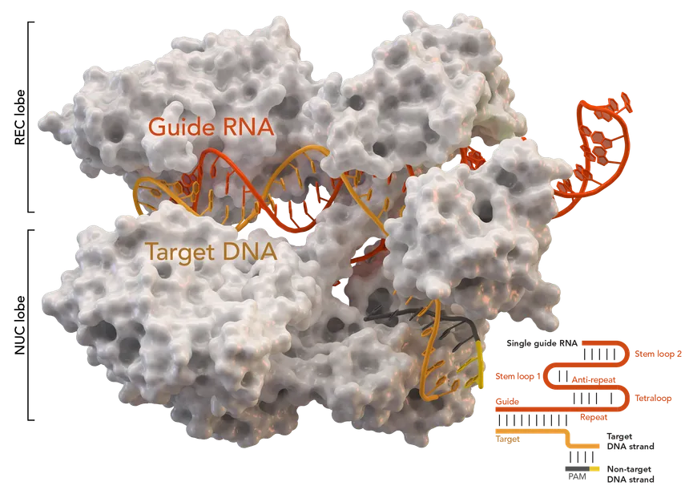
Notes:
Cas9 protein.
Can be programmed with a small RNA molecule to guide it to the specific DNA sequence, where it cuts the DNA
Molecular scissors.
Adapted as a genome editing tool

Slide 5
The Problem with CRISPR Visualization and Analysis
Comprehensive Tools
Investigate loci and sequences of DRs and spacers
Existing tools: CRT, PILER-CR, CRISPRFinder, etc.
Limitations of Current Tools:
Lack interactive and user-friendly visualization
Complexity and non-interactivity of Excel macros
Over-reliance on specific detection tools
Confusing visual outputs with complex datasets
Gap in the market
Need for an all-in-one tool to visualize, manipulate, and analyze CRISPR arrays effectively
Notes:
need for tools to visualize sequences of direct repeats and spacers
CrisprStudio and CRISPRFinder are examples
tools lack:
interactivity
not user friendly
complex
limited in visualization, CRISPRStudio only present spacers graphically

Slide 6

Why use Python?
Extensive Bioinformatics libraries
Biopython: sequence analysis and data manipulation
Pandas: efficient data handling and analysis
Matplotlib & Seaborn: powerful data visualization tools
Seamless integration with existing bioinformatics tools
Large, active community
Capable of handling large datasets efficiently

Slide 7





Python Libraries Used
Biopython: sequence analysis and manipulation
Pandas: efficient data organization and management
NumPy: handling large datasets
Matplotlib: creating visuals
Seaborn: high-level statistical graphics

Slide 8
Results

Slide 9
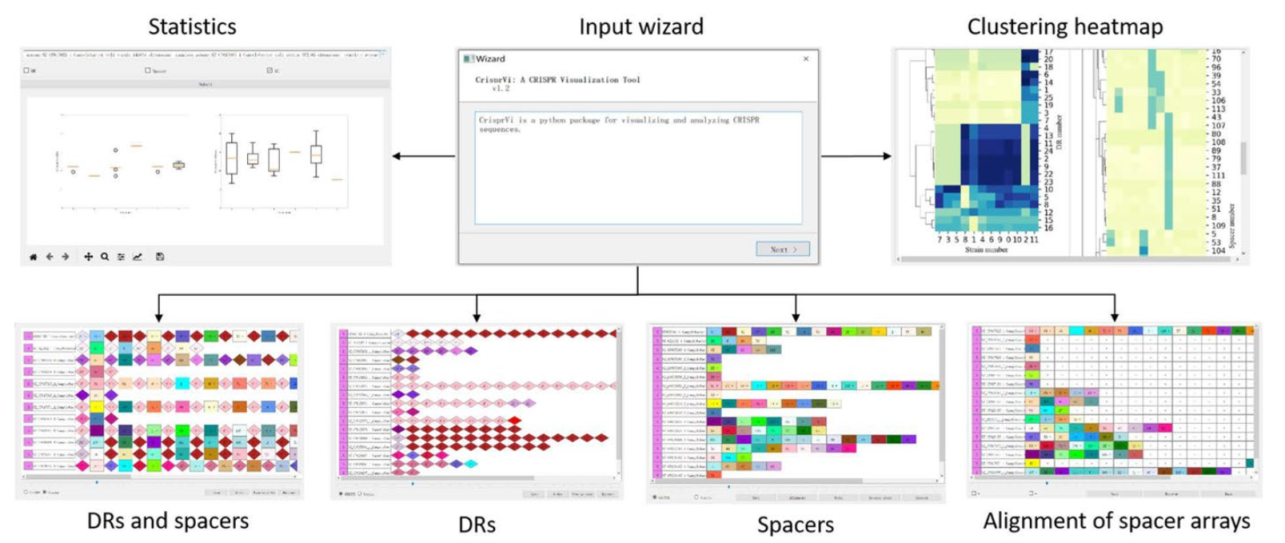
GUI Overview
Notes:
successfully develop a python package

Slide 10
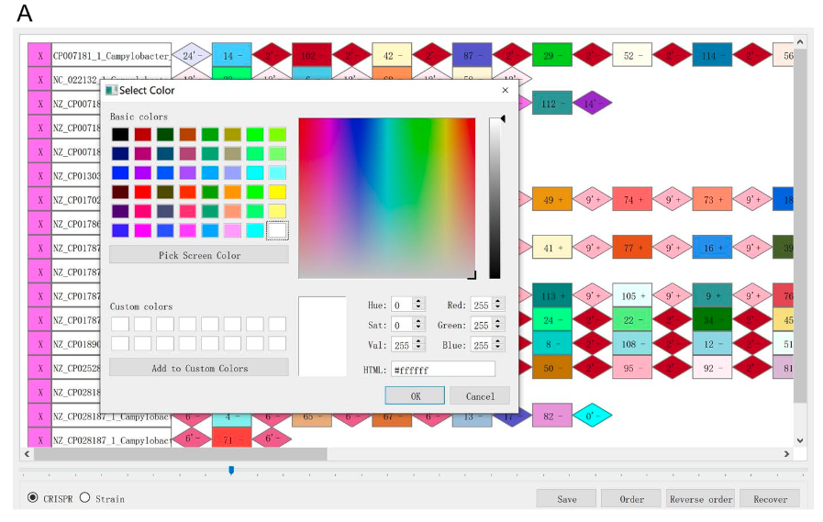
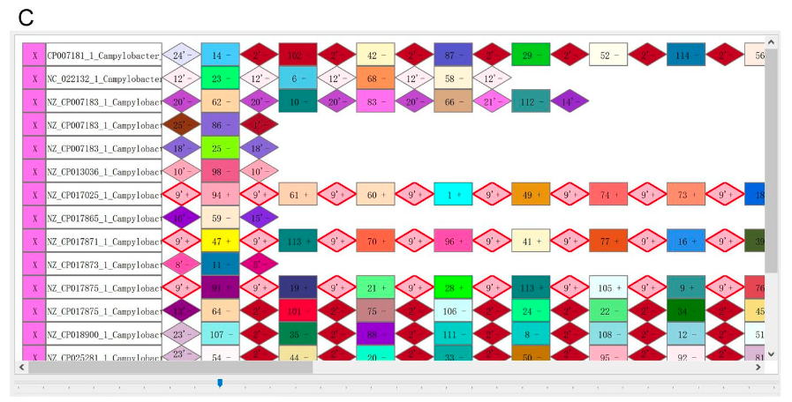
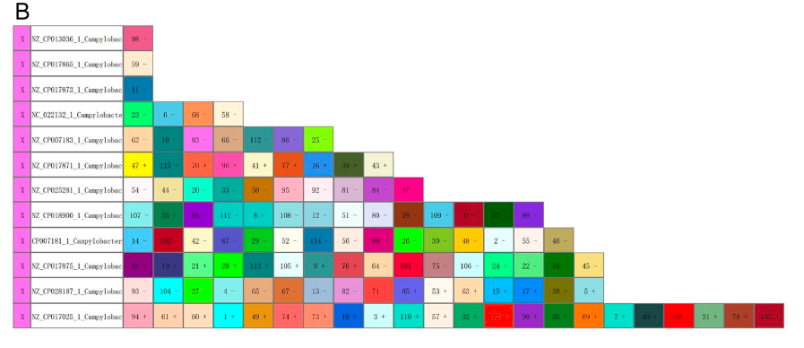
User can customize graphics for DRs/spacers
Notes:
Can change graphic color manually,
sort spacer arrays by length
highlight identical CRISPRs by red borders
Visualized CRISPRs of 12 C. Coli strains which where predicted by CRISPRCasFinder

Slide 11
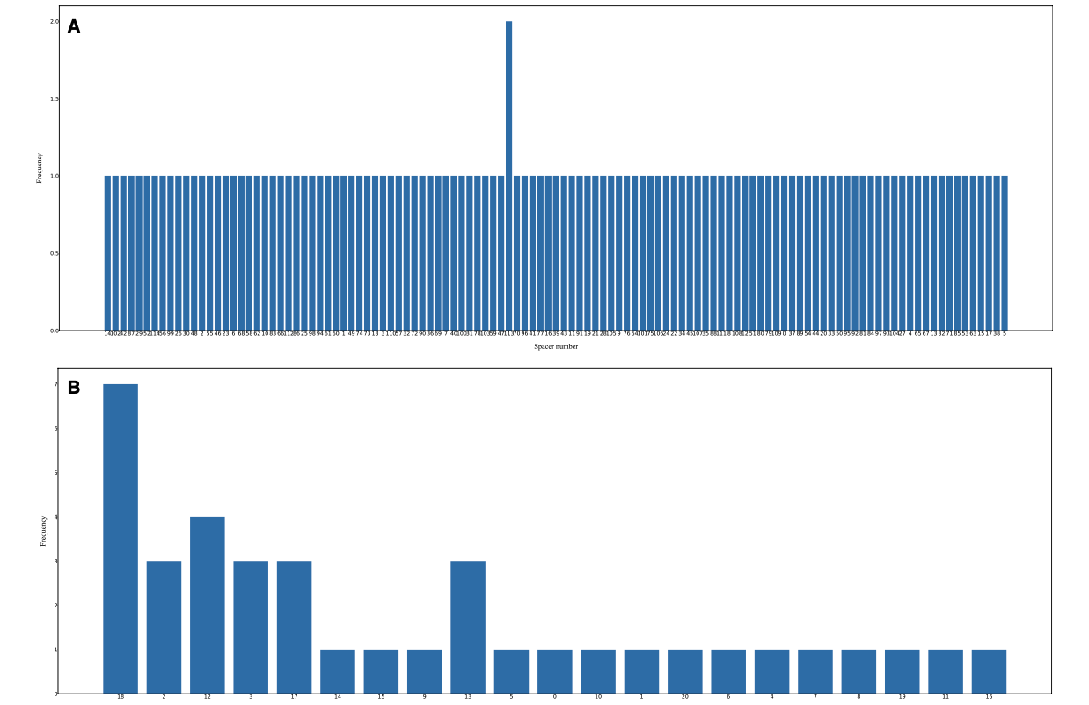
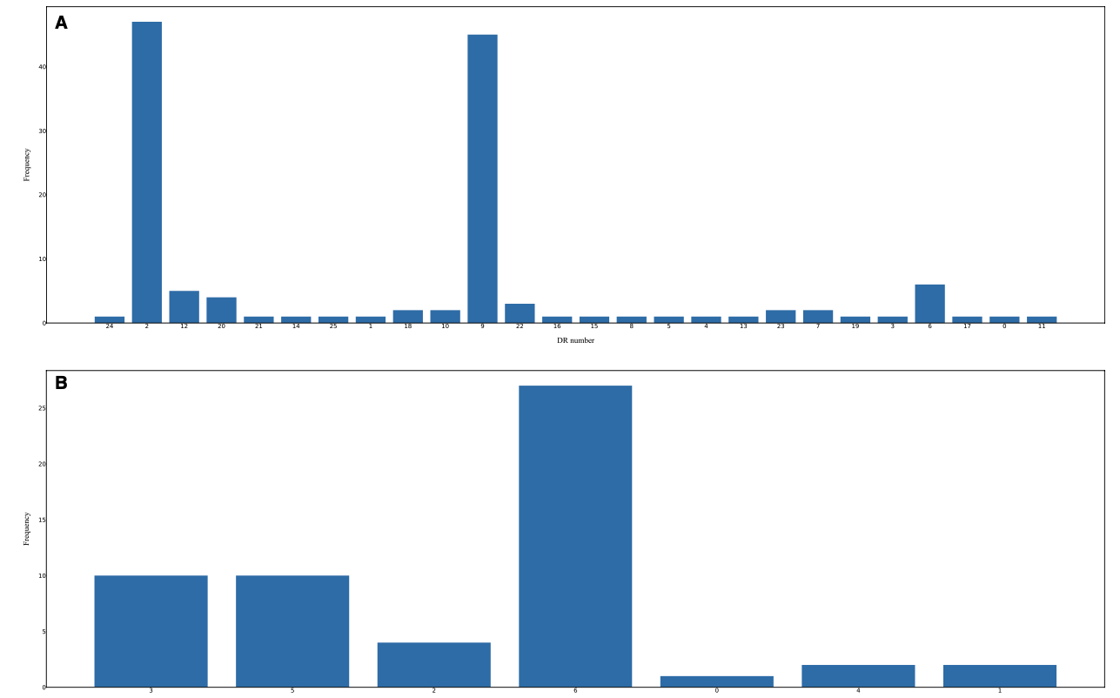
Perform statistical analysis of the DRs/spacers on selected strains
Notes:
can generate histograms for direct repeats
Similar for the Spacer count across strains
can inspect details of the plots using commands in the menu

Slide 12
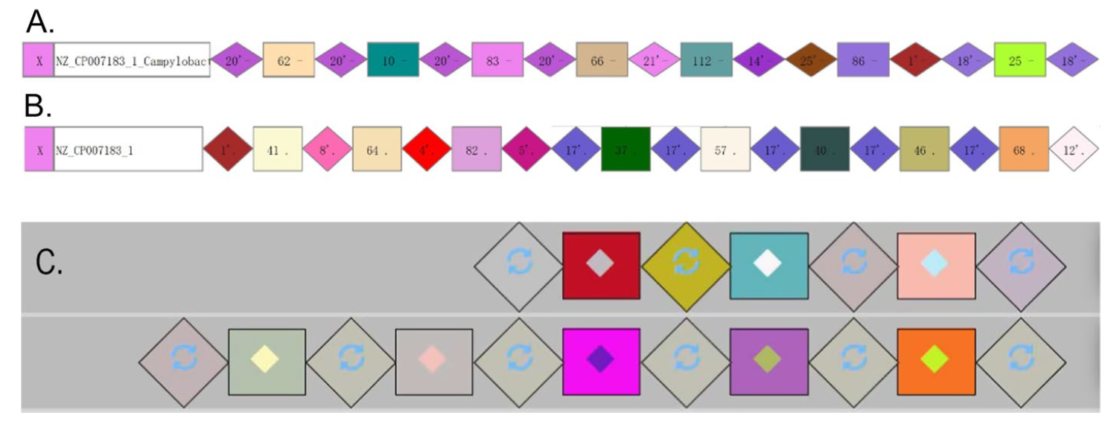
More Detailed Visualization
Notes:
CrisprViz is labeled C in the image, CrisprVi is labeled A and B, A and B is more flexible and provides more detailed visualization

Slide 13
My Thoughts
Feature | CrisprVi | CRISPRviz | CRISPRStudio
Visualization of DRs and Spacers | Yes | Yes | No (Only Spacers)
Customization | Yes | Limited | No
Interactive GUI | Yes | Yes | No
Statistical Analysis Tools | Yes | No | No
Accepts outputs from various CRISPR Finding tools | Yes | No (MinCED only) | No
Flexibility in CRISPR detection methods | Yes | No | No
Ability to change visualization settings | Yes | No | No
Efficiency (Data Loading Speed) | Moderate | Fast | N/A
Notes:
very innovative tool
addresses gap in visualization and analysis of Crispr sequences

Slide 14
References
Biopython. (n.d.). Biopython logo. Retrieved from https://biopython.org/wiki/logo
Jia, B., Zhang, X., Jiang, Q., Wang, Z., Zhang, Y., Hu, Y., & Wang, Y. (2022). CrisprVi: a software for visulaizing and analyzing CRISPR sequences of prokaryotes. BMC Bioinformatics, 23(1), 257. https://doi.org/10.1186/s12859-022-04716-9
Matplotlib developers. (n.d.). Matplotlib logo. Retrieved from https://matplotlib.org/stable/gallery/misc/logos2.html
NumPy developers. (n.d.). NumPy logo. Retrieved from https://github/com/numpy/numpy/tree/main/branding/logo
pandas development team. (n.d.). Pandas logo. Retrieved from https://pandas.pydata.org/about/citing.html
Python Software Foundation. (n.d.). Python logo. Retrieved from https://www.python.org/community/logos/
Seaborn developers. (n.d.). Seaborn logo. Retrieved from https://seaborn.pydata.org/citing.html
Splettstoesser, T. (n.d.). Cas9 protein structure [Image]. Wikimedia Commons. Retrieved from https://en.wikipedia.org/wiki/Cas9#/media/File:Cas9_5AXW.png

Slide 15
Questions?

